Slide 1
Example of simple Braitenberg Vehicle type of robot in Robot C with quantum logic

Slide 2
Quantum Logic
Boolean Logic
Quantum Logic
Uses matrices and vectors
State of a system is a vector
Basic vectors – system is in one state
Superposed vectors – system is in many states at the same time
Entanglement – system is in many states in such a way that it cannot be factorized.
EXOR/AND Logic
Reversible Logic
Quantum Logic
1 1 0 0
1 0 0 1
1/√2
1/√2
00
01
10
11
1 0 0 0
0 1 0 0
1 0 0 0
1 0 0 0
A superposed state that can be factorized
(separable)
A superposed state that is entangled (cannot be separated)
Basic vectors

Slide 3
Example of quantum robot: deterministic permutative matrix
000 001 010 011 100 101 110 111
000
001
010
011
100
101
110
111
1
 |  |  |  | 1
 |  |  |  |  | 1
 |  | 1
 |  |  |  |  |  | 1
 |  |  | 1
 |  |  |  |  |  |  | 1
 | 1
0 0 1
0
0
0
0
0
0 0 0
1
0
0
0
0
*
=
Matrix represents transformation
vector represents old state
vector represents new state

Slide 4
Example of quantum robot: deterministic permutative matrix
0 0 1 0 0 0 0 0
000 001 010 011 100 101 110 111
000
001
010
011
100
101
110
111
1
 |  |  |  | 1
 |  |  |  |  | 1
 |  | 1
 |  |  |  |  |  | 1
 |  |  | 1
 |  |  |  |  |  |  | 1
 | 1
0 0 1
0
0
0
0
0
0 0 0
1
0
0
0
0
000
001
010
011
100
101
110
111
*
=
Matrix represents transformation
vector represents old state
vector represents new state

Slide 5
Example of quantum robot: deterministic non-permutative matrix
Total state of inputs and internal states
000 001 010 011 100 101 110 111
000
001
010
011
100
101
110
111
4
 |  |  |  | 7
 |  |  |  |  | 1 |  | 4
 |  | 5
 |  |  |  |  |  | 6
 |  | 5 | 1
 |  |  |  |  |  |  | 4
 | 1
0 0 3
0
4
0
0
0
*
=
Different interpretation of results
Total state of outputs and internal states

Slide 6
Example of quantum robot: non-deterministic matrix, probabilistic intepretation
This is not a permutative matrix
Total state of inputs and internal states
000 001 010 011 100 101 110 111
000
001
010
011
100
101
110
111
1
 |  |  |  | 1
1 |  |  | 1 |  | 1
 |  | 1
 |  |  |  |  |  | 1
 |  |  | 1
 |  |  |  |  |  |  | 1
 | 1
Total state of outputs and internal states

Slide 7
Example of quantum robot: deterministic permutative matrix
0 0 1 0 0 0 0 0
000 001 010 011 100 101 110 111
000
001
010
011
100
101
110
111
1
 |  |  |  | 1
 |  |  |  |  | 1
 |  | 1
 |  | 1 |  |  |  | 1
 |  |  | 1
 |  |  |  |  |  |  | 1
 | 1
0 0 1
0
0
0
0
0
0 0 0
1
1
0
0
0
000
001
010
011
100
101
110
111
*
=
Matrix represents transformation
vector represents old state
vector represents new state

Slide 8
Example of quantum robot: deterministic permutative matrix
System is in two states at the same time, 011 and 100
0 0 0
1
1
0
0
0
000
001
010
011
100
101
110
111
System is in two states at the same time, 011 and 100
But after “measurement” system goes to one state with probability of ½ to be measured in state 011 and probability ½ to be measured in state 100
vector represents new state

Slide 9
State representation
Easy to calculate new states
Has many applications in various types of systems (linear)
Use in image processing, vision, control, prediction, quantum computing, reversible computing.
Relation to probabilistic systems.
Can use Boolean, integer, complex values, etc.
Easy to calculate in Matlab.

Slide 10
Robot C language
It will take you about one hour to learn if you know C.
It is implemented on many computers
It is used in high school competitions
It is on Lego and VEX, Tetrix etc.
It helps with sensors and motors, you do not worry about the details, has PID etc.
Unfortunately you have to pay.
You can get license for few months for free.
My high school kids have done great software.

Slide 11
Example of programming a quantum robot
This program can be easily changed to the following types of control:
Boolean Logic
Fuzzy logic
Probabilistic logic
Ternary logic
Mixed logic
Your own control for any algebra you may want

Slide 12
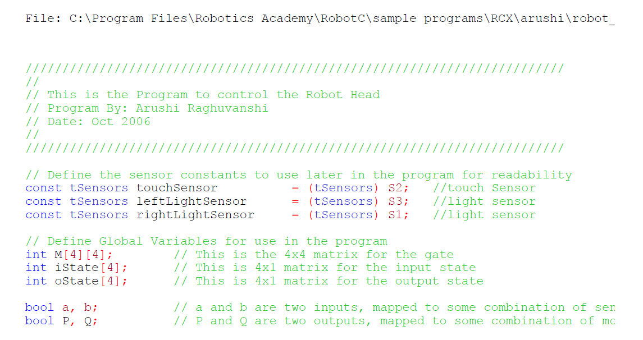
A fourteen years old girl wrote it in few hours!
We declare one touch sensor and two light sensors

Slide 13
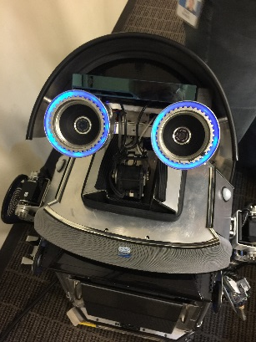
We declare the matrix of transformation, in this case permutative
We link the Boolean inputs to state of the input of our linear system
Review matrices and vectors
Review how to multiply matrix by vector
Review how to multiply matrix by matrix
I hope you remember!

Slide 14
For loop flowchart
}
}
}
We calculate the new state of the linear system based on its old state and the transformation matrix

Slide 15
For loop flowchart
start
i=0
External loop
Ostate[i]=0
Internal loop
j=0
j=j+1
yes
j < 4
no
i=i+1
yes
i < 4
no

Slide 16
I hope you remember!
Review quantum measurement
Review probability

Slide 17
For loop flowchart
start
i=0
Ostate[i]=0
j=0
j=j+1
yes
j < 4
no
i=i+1
yes
i < 4
no
end

Slide 18
Initialize total
oneCounter counts ones
Calculate new value of total
Calculate value of output

Slide 19
Continue of subroutine of interpreting the output state
Calculate deterministic values of control variables P and Q
Loop for oneCounter

Slide 20
Translates output Boolean variables P and Q to actions of motors
Output Motion routine is for motors

Slide 21
Converts sensor reading to input variables a and b
Two light sensors and touch sensor
Input routine is for sensors
Two light sensors and touch sensor

Slide 22
Main program links inputs, outputs and brain (behavior)
Intialize all
input
brain
output

Slide 23
Typical Problems for homeworks, quizzes and projects
Create shy Braitenberg Vehicle based on principles explained in this set of slides.
Create shy Braitenberg Vehicle that you can control its “shyness”
Create aggressive Braitenberg Vehicle with probabilistic behaviors, based on “pseudo-quantum” logic from this set of slides.
Create a Braitenberg Vehicle that with clasping your hands you can change the behavior from shy to aggressive and vice versa. The robot should have probabilistic behavior and behave differently in every moment of time, with high probability.
Create a Braitenberg Vehicle (mobile robot) with lights on top of head, observe two robots interaction. Change robots’ behaviors using parameters.
Create a humanoid robot based on the principles discussed in this set of slides.
Combine the logic from this set of slides with fuzzy logic to describe behavior of some robot.

